Slide 1
Case Studies
https://poloclub.github.io/cnn-explainer/
https://adamharley.com/nn_vis/cnn/3d.html

Slide 2
Klasik modeller:
ResNet
LeNet-5
Inception
AlexNet
MobileNet
VGG
EfficientNet

Slide 3
LeNet - 5
avg pool
avg pool
$$\hat{y}$$
5$×$ 5
s = 1
f = 2
s = 2
5$×$ 5
s = 1
f = 2
s = 2
$$⋮$$
$$⋮$$
32$×$32 $×$1
28$×$28$×$6
14$×$14$×$6
10$×$10$×$16
5$×$5$×$16
120
84
[LeCun et al., 1998. Gradient-based learning applied to document recognition]

Slide 4
AlexNet
MAX-POOL
MAX-POOL
11$×$ 11
s = 4
3$×$ 3
s = 2
5$×$ 5
same
3$×$ 3
s = 2
55$×$55 $×9$6
27$×$27 $×$96
27$×$27 $×$256
13$×$13 $×$256
227$×$227 $×$3
MAX-POOL
=
3$×$ 3
same
3$×$ 3
3$×$ 3
3$×$ 3
s = 2
$$⋮$$
$$⋮$$
$$⋮$$
Softmax
1000
13$×$13 $×$384
13$×$13 $×$384
13$×$13 $×$256
6$×$6 $×$256
9216
4096
4096
[Krizhevsky et al., 2012. ImageNet classification with deep convolutional neural networks]

Slide 5
VGG - 16
CONV = 3$×$3 filter, s = 1, same
MAX-POOL = 2$×$2 , s = 2
224$×$224$×$64
112$×$112 $×$64
112$×$112 $×$128
56$×$56 $×$128
[CONV 64]
$×$2
POOL
[CONV 128]
$×$2
POOL
224$×$224 $×$3
56$×$56 $×$256
28$×$28 $×$256
28$×$28 $×$512
14$×$14$×$512
[CONV 256]
$×$3
POOL
[CONV 512]
$$×3$$
POOL
14$×$14 $×$512
7$×$7$×$512
FC
FC
Softmax
[CONV 512]
$×$3
POOL
4096
4096
1000
[Simonyan & Zisserman 2015. Very deep convolutional networks for large-scale image recognition]

Slide 6
Residual Networks (ResNets)

Slide 7
Residual block
$$a^{[l+1]}$$
$$a^{[l]}$$
$$a^{[l+2]}$$
$$z^{[l+1]}{=W}^{[l+1]}a^{[l]}+b^{[l+1]}$$
$$a^{[l+1]}=g(z^{[l+1]})$$
$$z^{[l+2]}= W^{[l+2]}a^{[l+1]}+b^{[l+2]}$$
$$a^{[l+2]}=g(z^{[l+2]})$$
[He et al., 2015. Deep residual networks for image recognition]

Slide 8
Residual Network
$$x$$
$$a^{[l]}$$
Plain
ResNet
training error
training error
# layers
# layers
[He et al., 2015. Deep residual networks for image recognition]

Slide 9

1$×$1 convolutions

Slide 10
Why does a 1 $×$ 1 convolution do?
1 | 2 | 3 | 6 | 5 | 8
3 | 5 | 5 | 1 | 3 | 4
2 | 1 | 3 | 4 | 9 | 3
4 | 7 | 8 | 5 | 7 | 9
1 | 5 | 3 | 7 | 4 | 8
5 | 4 | 9 | 8 | 3 | 5
$$∗$$
2
$$=$$
6 $×$ 6
$$∗$$
$$=$$
6 $×$ 6 $×$ 32
1 $×$ 1 $×$ 32
6 $×$ 6 $×$ # filters
[Lin et al., 2013. Network in network]

Slide 11
Using 1$×$1 convolutions
ReLU
CONV 1 $×$ 1
32
28 $×$ 28 $×$ 32
28 $×$ 28 $×$ 192
[Lin et al., 2013. Network in network]

Slide 12
Inception network

Slide 13
Motivation for inception network
1 $×$ 1
3 $×$ 3
64
5 $×$ 5
128
28
32
32
28
28 $×$ 28 $×$ 192
MAX-POOL
[Szegedy et al. 2014. Going deeper with convolutions]
Note: the colors are intended to correspond to the stacked small hand drawn cube

Slide 14
The problem of computational cost
CONV
5 $×$ 5,
same,
32
28 $×$ 28 $×$ 32
28 $×$ 28 $×$ 192

Slide 15
Using 1$×$1 convolution
CONV
1 $×$ 1,
16,
1 $×$ 1 $×$ 192
CONV
5 $×$ 5,
32,
5 $×$ 5 $×$ 16
28 $×$ 28 $×$ 16
28 $×$ 28 $×$ 32
28 $×$ 28 $×$ 192

Slide 16
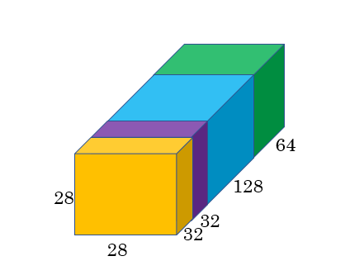
Inception module
1 $×$ 1 CONV
1 $×$ 1 CONV
3 $×$ 3 CONV
Previous Activation
Channel Concat
1 $×$ 1 CONV
5 $×$ 5 CONV
MAXPOOL 3 $×$ 3,s = 1 same
1 $×$ 1 CONV

Slide 17
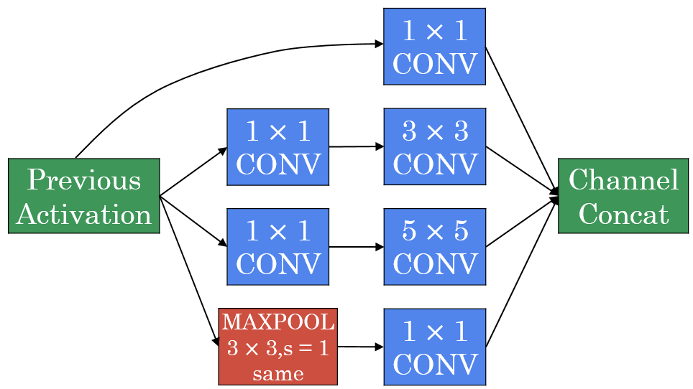

Inception network
[Szegedy et al., 2014, Going Deeper with Convolutions]

Slide 18
http://knowyourmeme.com/memes/we-need-to-go-deeper

Slide 19
MobileNet

Slide 20
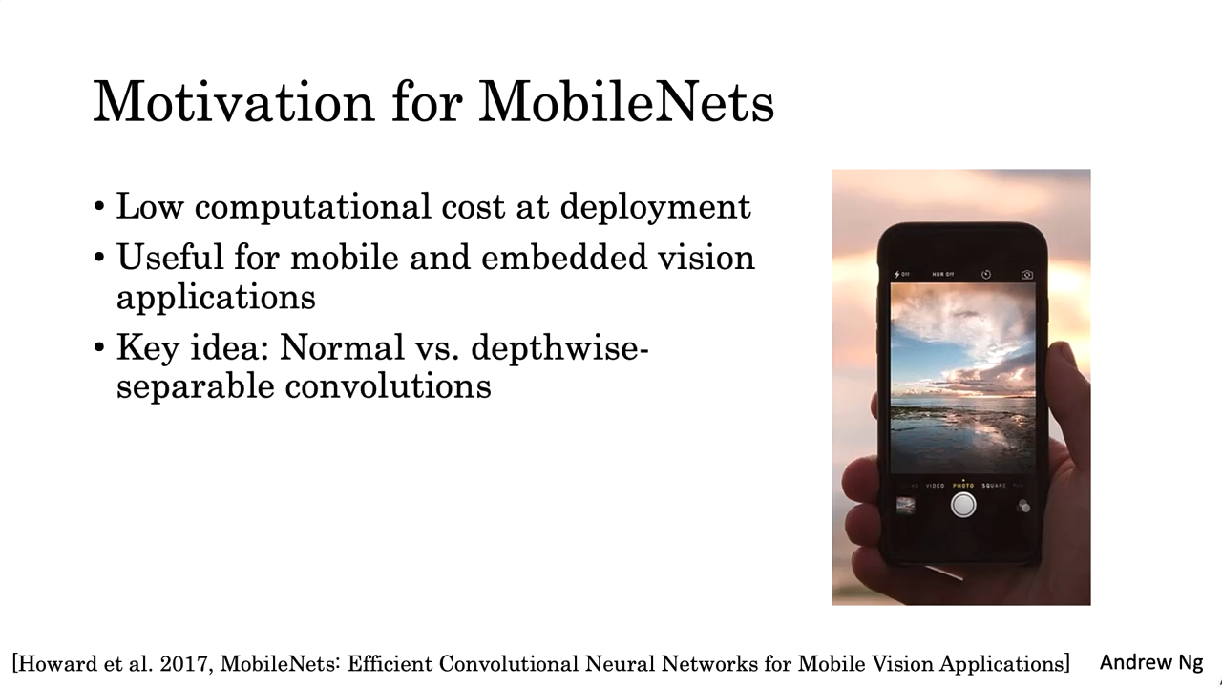

Slide 21
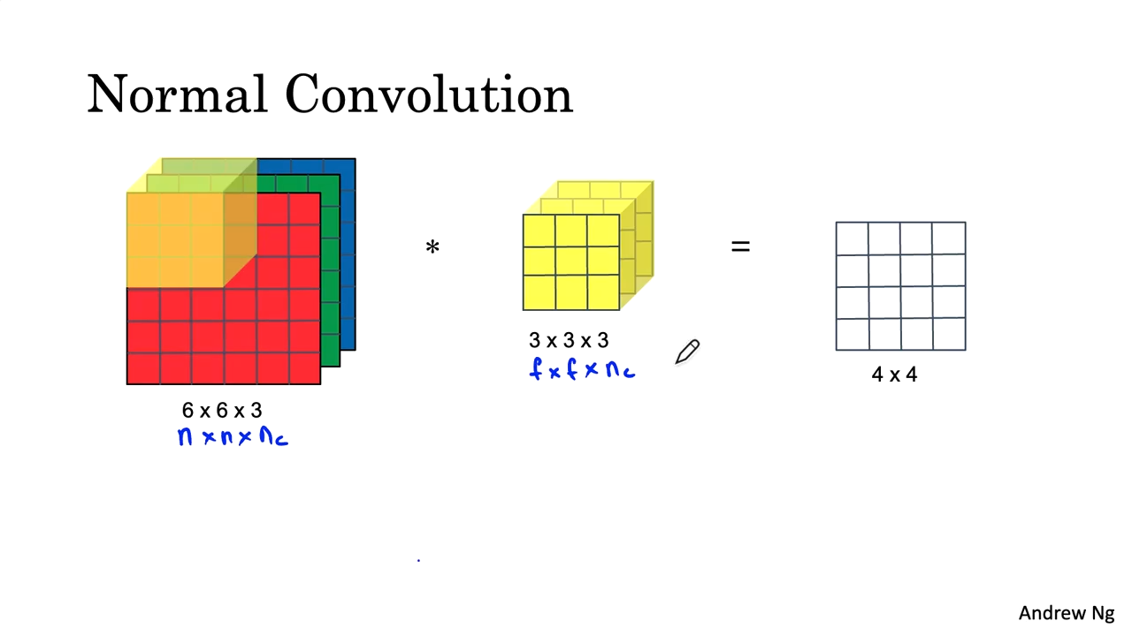

Slide 22
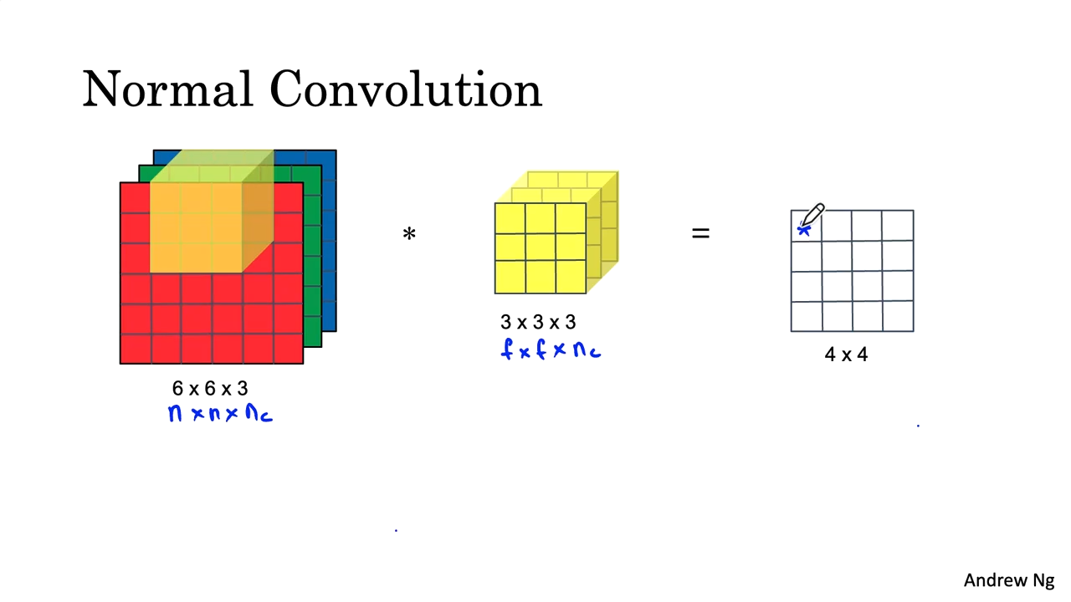

Slide 23
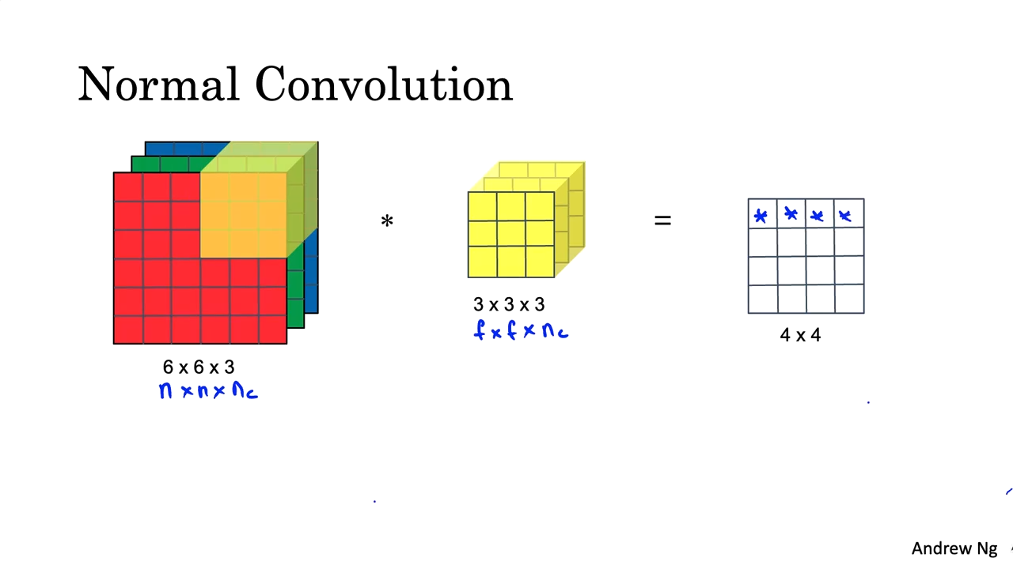

Slide 24
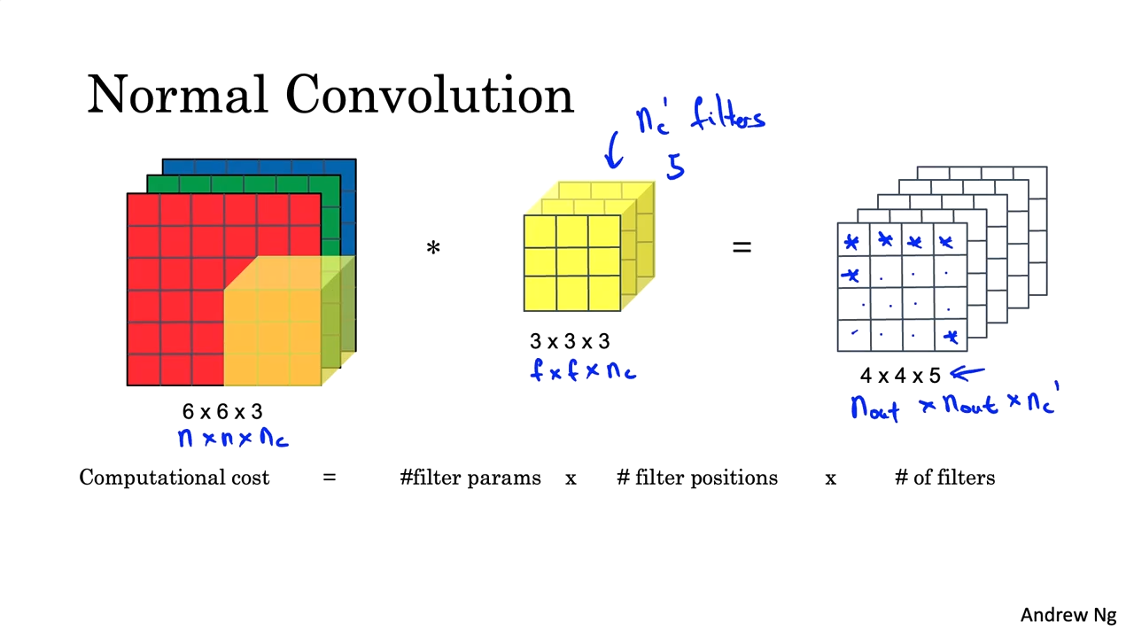

Slide 25
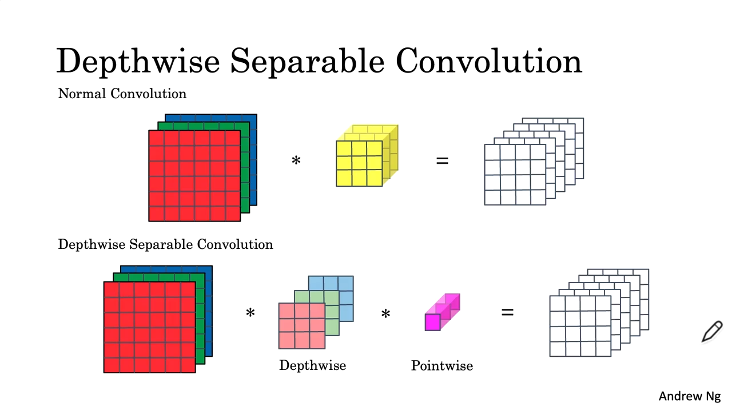

Slide 26
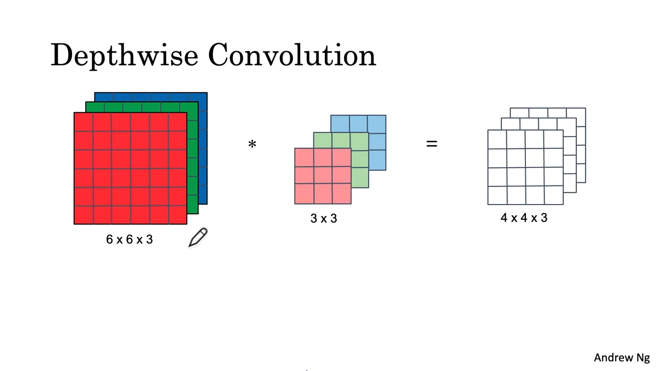

Slide 27
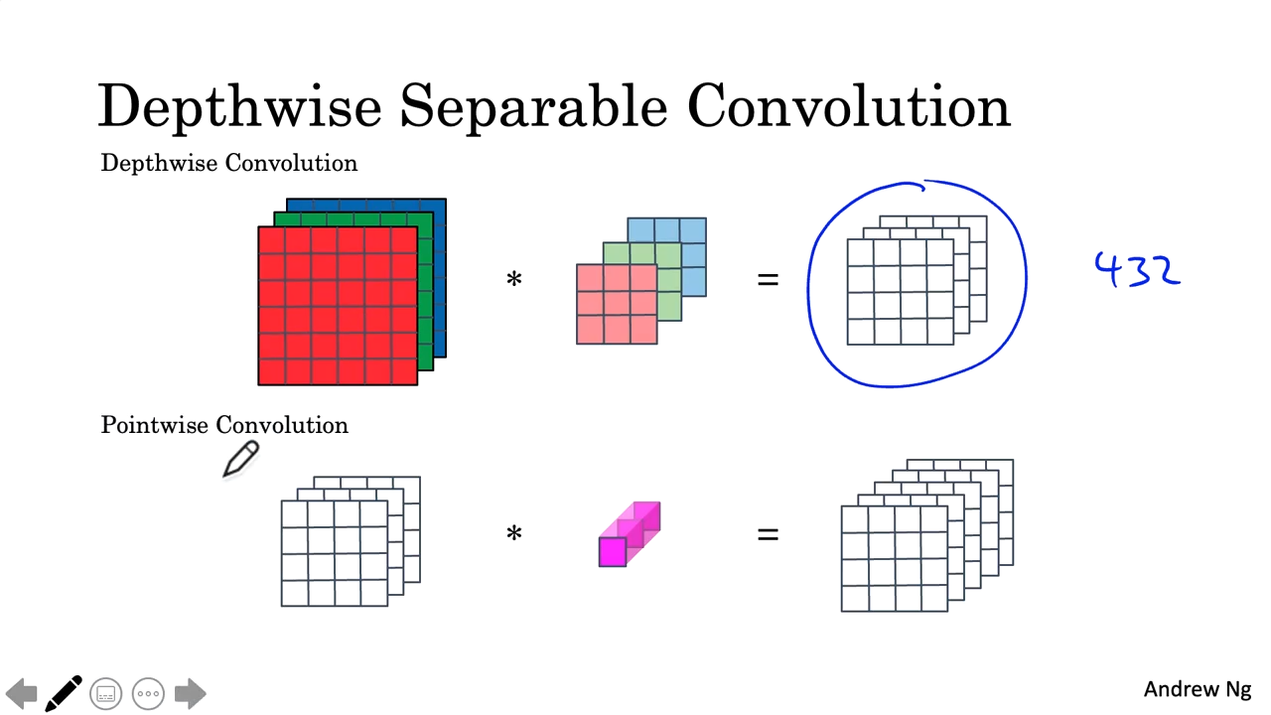

Slide 28
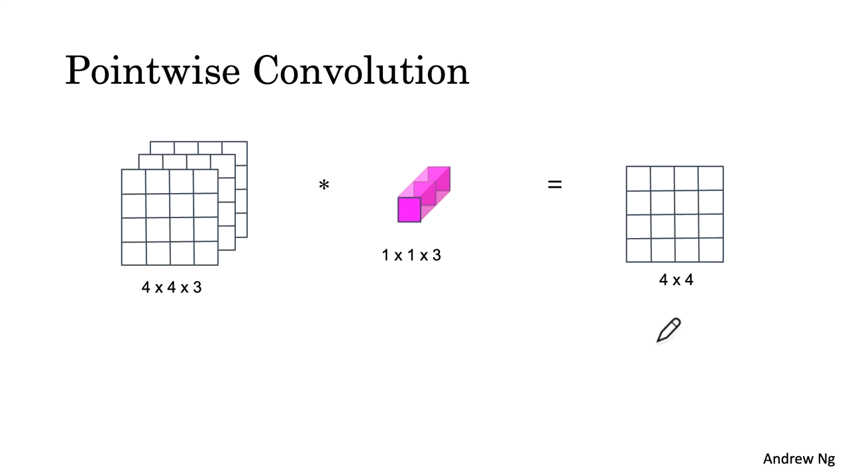

Slide 29
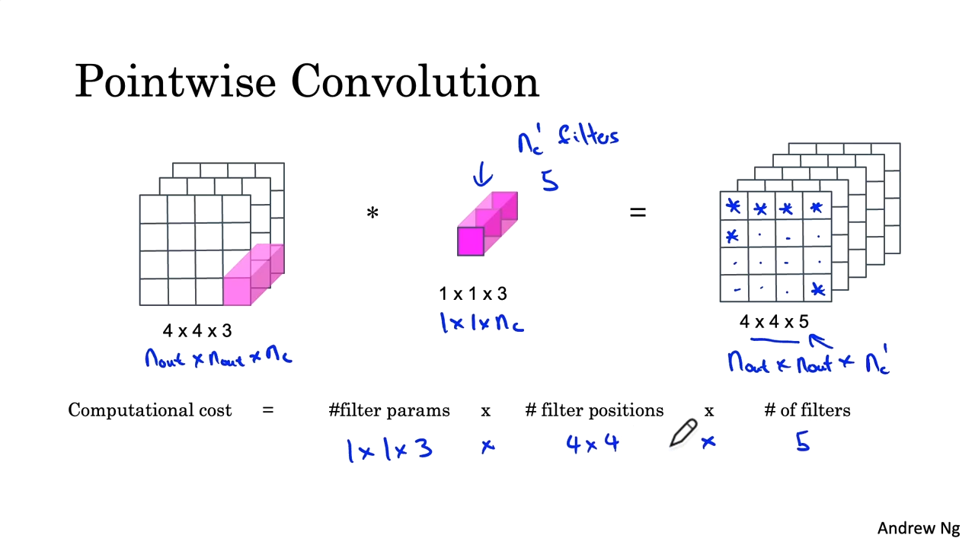

Slide 30


Slide 31
EfficientNet

Slide 32
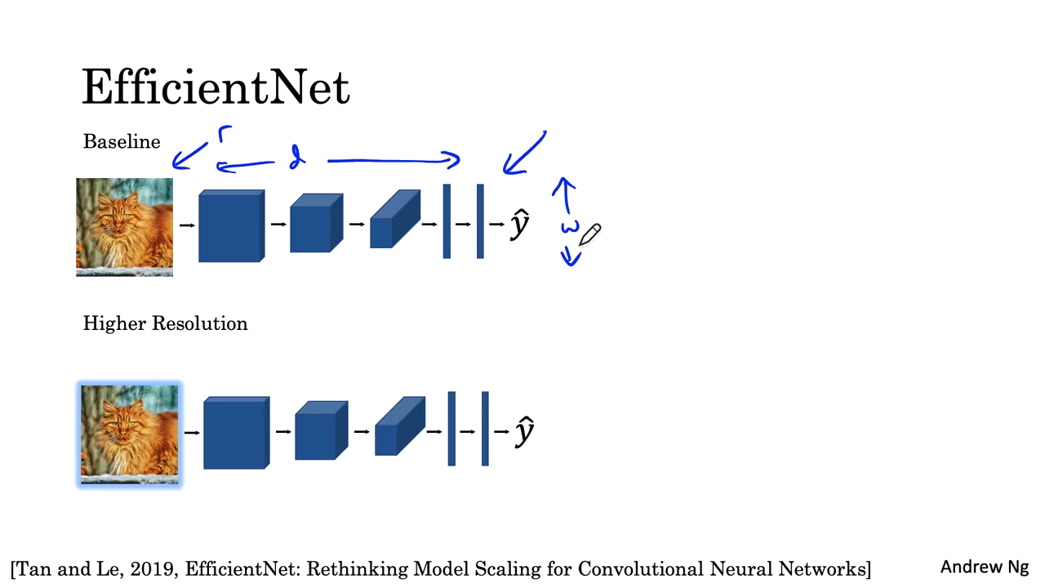

Slide 33
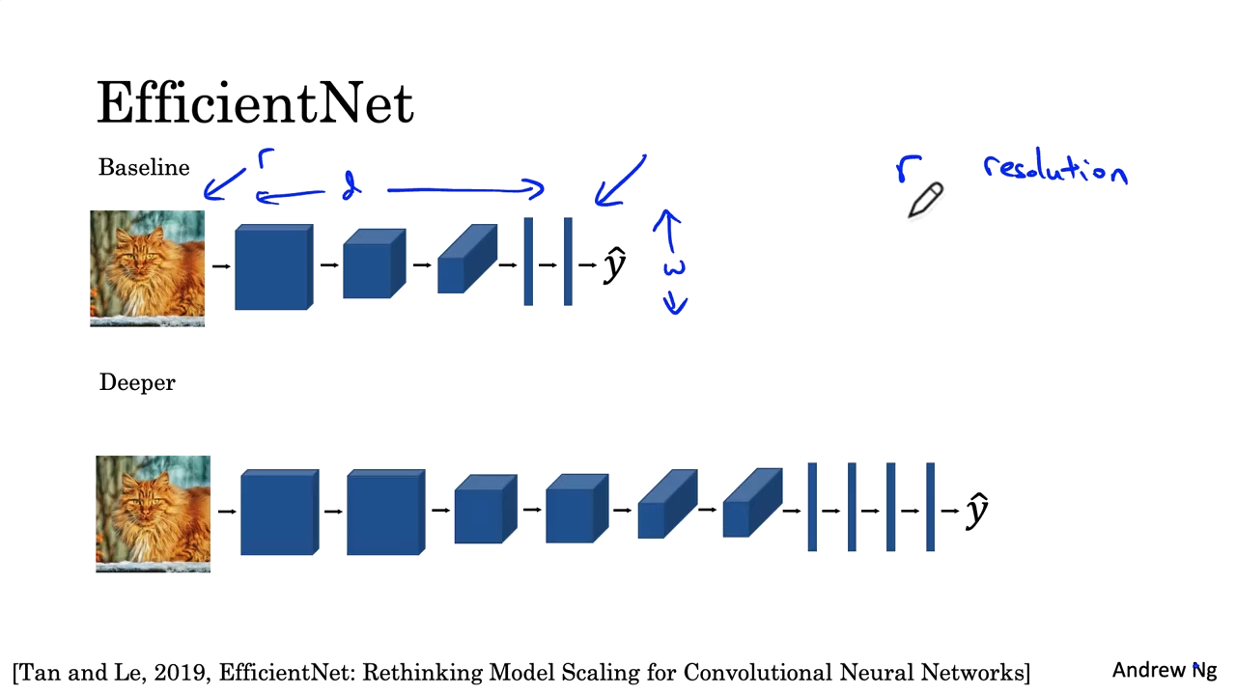

Slide 34
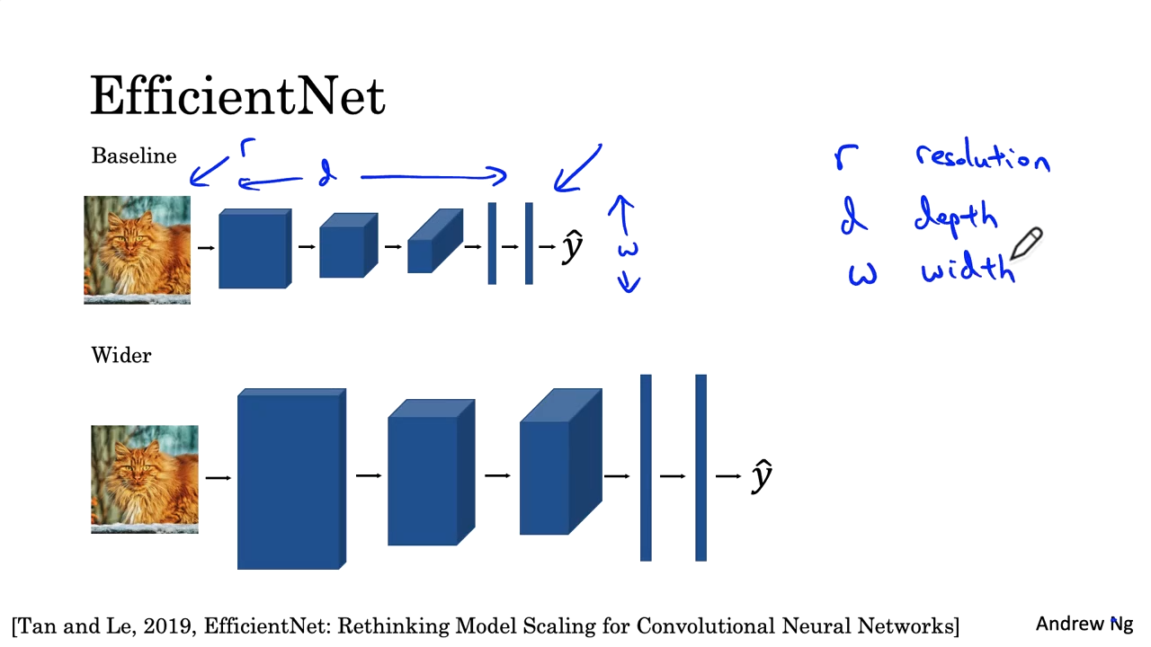

Slide 35
Literatürde yayınlanan ağ mimarilerini kullanın.
Mümkünse açık kaynak uygulamalarını kullanın.
Önceden eğitilmiş modeller kullanın ve veri setinizde ince ayar yapın.

Slide 36
Veri Arttırma

Slide 37
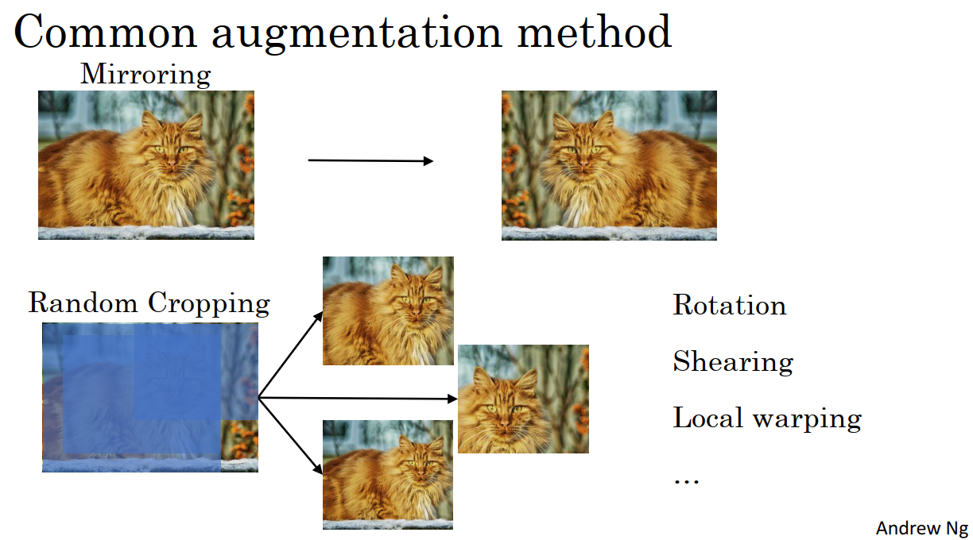
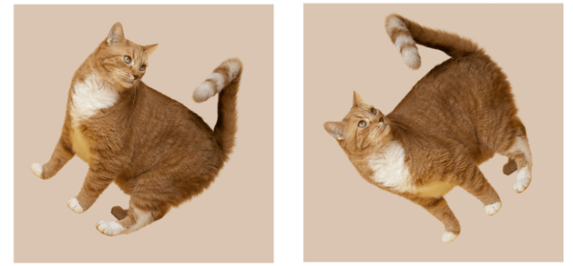
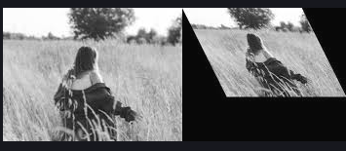
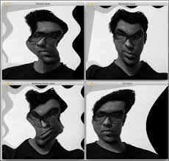

Slide 38
